Slide 1



Is Java compiled or Interpreted ?

Slide 2



Slide 3

Is .............

Slide 4


Slide 5
How ?????
Java is compiled and interpreted language which is done in two steps.
Java and the JVM were designed with portability in mind.
The javac command-line tool compiles Java source code into Java class files containing platform-neutral bytecode.
The compiled class files (bytecode) can be executed by the Java Virtual Machine (JVM).

Slide 6

JDK ?
JRE ?
JVM ?

Slide 7
JDK ?
JDK stands for Java Development kit.
It includes JRE and other development tools.
Tools like java compiler(javac), javadoc generator.
JRE
DEV TOOLS
JAVA ,JAVAC

Slide 8
JRE ?
JRE stands for Java Runtime Environment.
It is the implementation of JVM.
It includes java run time libraries and .class files.
JVM
RUN TIME LIBRARIES
JAVA PACKAGES

Slide 9
JVM ?
JVM stands for Java Virtual Machine.
It is called a virtual machine because it doesn't physically exist.
It will execute the java byte code line by line.
JVM
CLASS LOADER
EXECUTION ENGINEE

Slide 10

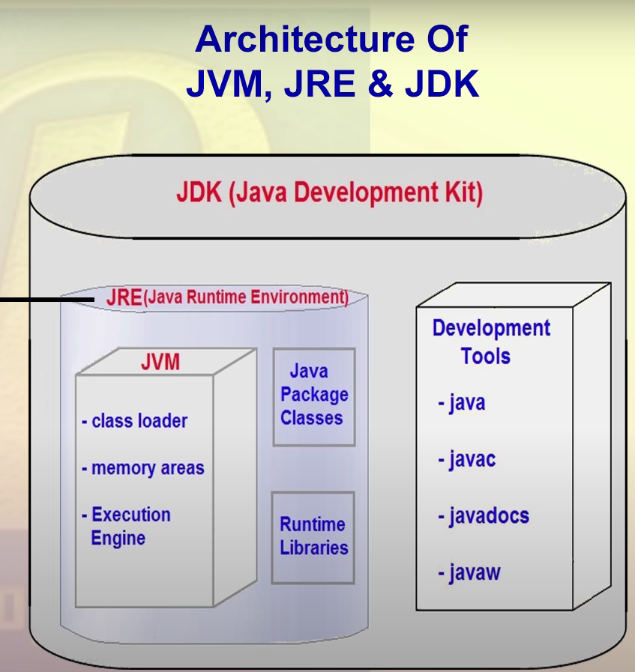

Slide 11

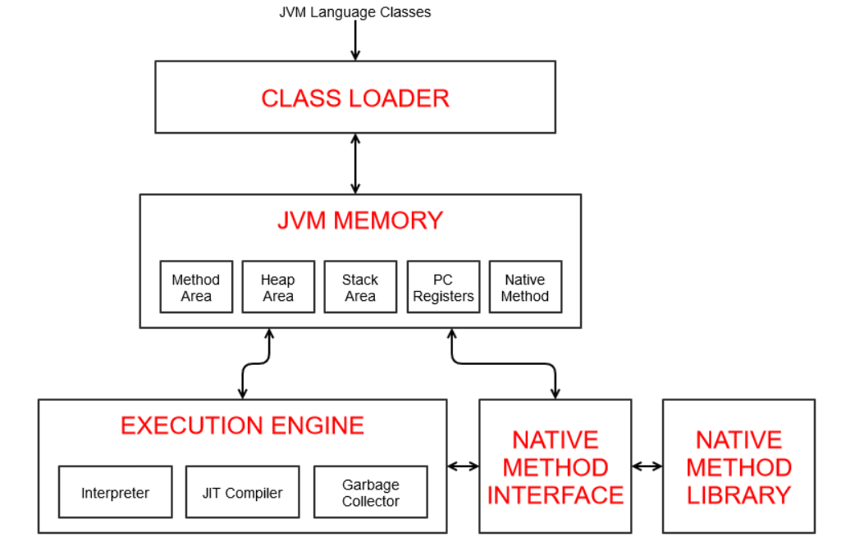
JVM Architecture

